Slide 1
SALESFORCE DEVELOPER
A CRM APPLICATION TO MANAGE THE MALL
TEAM MEMBERS
K.S. BHARATHI
B. ARCHANA
S. SUMITHA
Y.MOMINA BEE

Slide 2
Objective :
To enhance mall management through Customer Relationship Management (CRM) by streamlining operations, improving tenant relationships, and delivering a personalized shopping experience for customers.
- Provides a centralized system for customer and tenant management
- Improves customer engagement and retail tenant relations
- Enables data-driven decision-making for mall operations
- Provides a centralized system for customer and tenant management
- Improves customer engagement and retail tenant relations
- Enables data-driven decision-making for mall operations

Slide 3
Why Use Salesforce for Mall CRM?
Salesforce offers a robust CRM solution for malls by centralizing customer data, allowing personalized marketing, tracking foot traffic, and enhancing customer service. Its analytics provide insights on shopper behavior, helping retailers optimize promotions and loyalty programs. Additionally, Salesforce’s cloud-based platform enables easy scalability and real-time updates, ensuring seamless management across multiple stores and locations.
Customizable to mall-specific requirements
Offers seamless integration with existing systems (e.g., POS, marketing)Scalable for large-scale and multi-location malls
Provides robust analytics and AI capabilities

Slide 4
Key CRM features for mall management in Salesforce
~ centralized customer data,
~ personalized marketing,
~ real-time analytics,
~ automated loyalty programs,
~ enhancing shopper engagement and store performance.
It also supports tenant management, foot traffic analysis, and seamless communication with retail partners.
*Tenant Management*: Track lease terms, occupancy rates, and sales performance
*Customer Engagement*: Manage loyalty programs, personalized marketing, and promotions
- *Events & Campaigns*: Plan and manage events and mall-wide promotions
- *Analytics & Reporting*: Real-time insights on foot traffic, sales, and customer preferences

Slide 5
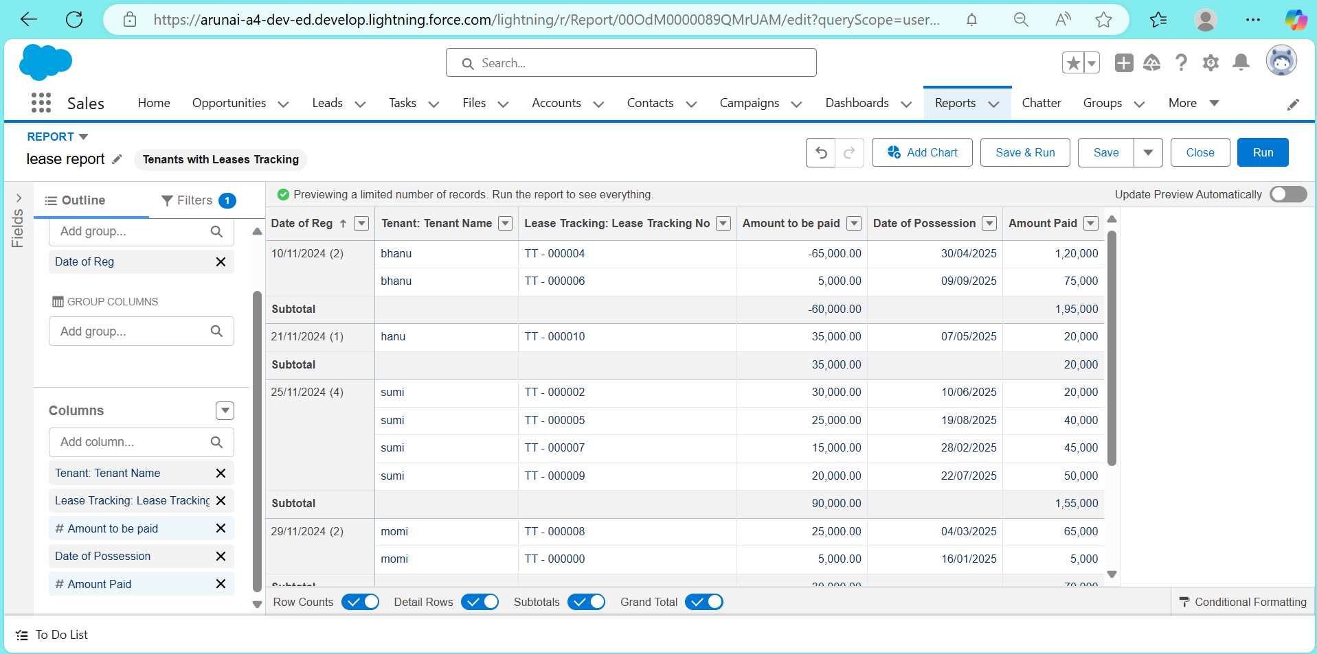
Tenant Management
Lease record

Slide 6
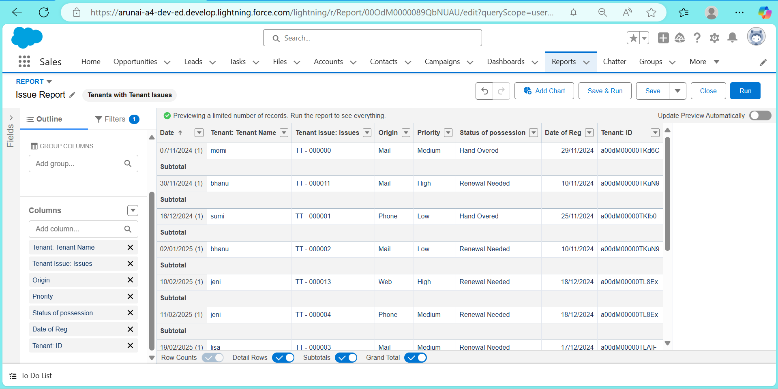
Issues record

Slide 7
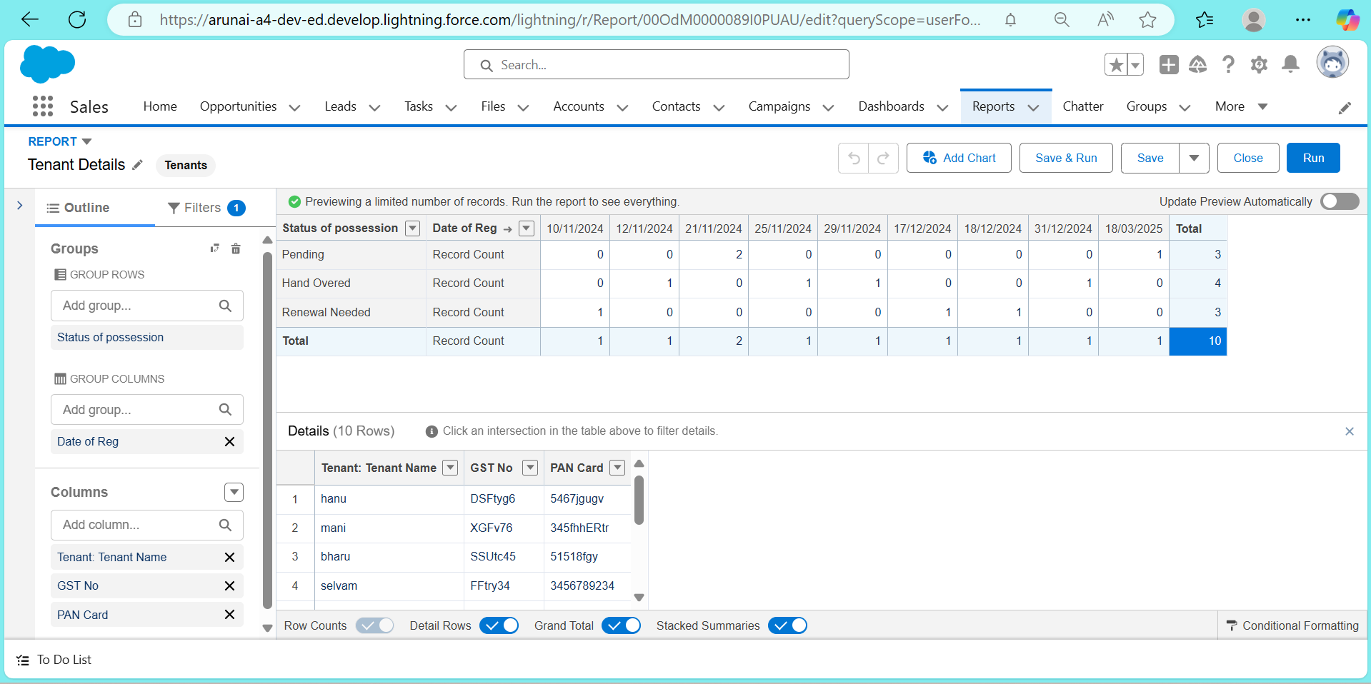
Tenants details

Slide 8
Enhancing Customer Experience :
- Build customer profiles and track shopping preferences
- Personalized marketing through email, SMS, and push notifications
- Set up loyalty rewards and manage customer feedback

Slide 9
Data-Driven Decisions with Analytics*-
- Foot traffic analysis to optimize layout and tenant placement
- Sales and revenue tracking per store and category
- Predictive insights for trends and customer demands using Salesforce AI

Slide 10
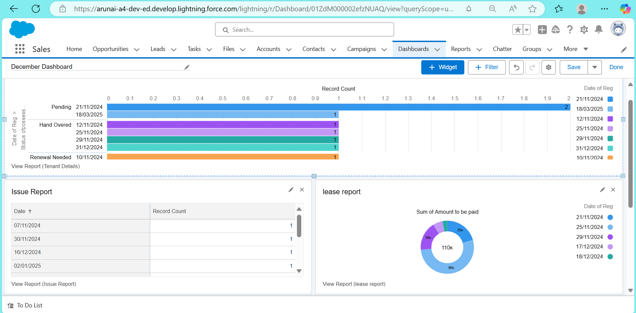

Conclusion
-Salesforce CRM provides a holistic approach to mall management
- Enhances tenant satisfaction, improves customer engagement, and boosts overall revenue
Next Steps
- Initial CRM setup
- Onboarding mall staff and tenants to the system
- Begin data collection and campaign launches

